Slide 1
Prime Numbers
An integer p>1 is prime iff it is not the product of two integers greater than 1: p>1 ∧ ¬∃a,b∈N: a>1, b>1, ab=p.
The only positive factors of a prime p are 1 and p itself. Some primes: 2,3,5,7,11,13...
Non-prime integers greater than 1 are called composite, because they can be composed by multiplying two integers greater than 1.

Slide 2
Review
a|b ⇔ “a divides b” ⇔ ∃c∈Z: b=ac
“p is prime” ⇔ p>1 ∧ ¬∃a∈N: (1 < a < p ∧ a|p)
Terms factor, divisor, multiple, composite.

Slide 3
Fundamental Theorem of Arithmetic
Its "Prime Factorization"
Every positive integer has a unique representation as the product of a non-decreasing series of zero or more primes.
Some examples:
1 = (product of empty series) = 1
2 = 2 (product of series with one element 2)
4 = 2·2 (product of series 2,2)
2000 = 2·2·2·2·5·5·5; 2001 = 3·23·29; 2002 = 2·7·11·13; 2003 = 2003 (no clear pattern!)
Later, we will see how to rigorously prove the Fundamental Theorem of Arithmetic, starting from scratch!

Slide 4
Theorem 2
If n is a composite integer, then n has a prime divisor less than or equal to .

Slide 5
Theorem 3
There are infinitely many primes.
We assume that there is a largest prime number. Call it p.
Hence, the set of all primes lie between 1 and p.
Form the product of these primes:
r = 2•3•5•7•11•....•p.
But r + 1 is a prime larger than p. (Why?).
This contradicts the assumption that there is a largest prime.

Slide 6
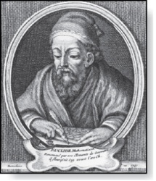
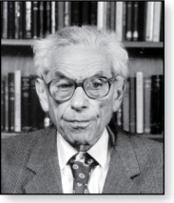
Infinitude of Primes
Theorem: There are infinitely many primes. (Euclid)
Proof: Assume finitely many primes: p₁, p₂, ….., p_{n}
Let q = p₁p₂∙∙∙ p_{n} + 1
Either q is prime or by the fundamental theorem of arithmetic it is a product of primes.
But none of the primes p_{j} divides q since if p_{j} | q, then p_{j} divides q − p₁p₂∙∙∙ p_{n} = 1 .
Hence, there is a prime not on the list p₁, p₂, ….., p_{n}. It is either q, or if q is composite, it is a prime factor of q. This contradicts the assumption that p₁, p₂, ….., p_{n} are all the primes.
Consequently, there are infinitely many primes.
Euclid
(325 B.C.E. – 265 B.C.E.)
This proof was given by Euclid The Elements. The proof is considered to be one of the most beautiful in all mathematics. It is the first proof in The Book, inspired by the famous mathematician Paul Erdős’ imagined collection of perfect proofs maintained by God.
Paul Erdős
(1913-1996)

Slide 7
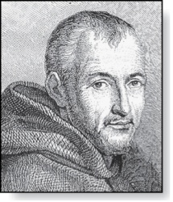
Mersenne Primes
Marin Mersenne
(1588-1648)
Definition: Prime numbers of the form 2^{p} − 1 , where p is prime, are called Mersenne primes.
2² − 1 = 3, 2³ − 1 = 7, 2⁵ − 1 = 37 , and 2⁷ − 1 = 127 are Mersenne primes.
2¹¹ − 1 = 2047 is not a Mersenne prime since 2047 = 23∙89.
There is an efficient test for determining if 2^{p} − 1 is prime.
The largest known prime numbers are Mersenne primes.
As of mid 2011, 47 Mersenne primes were known, the largest is 2^{43,112,609} − 1, which has nearly 13 million decimal digits.
The Great Internet Mersenne Prime Search (GIMPS:梅森素数大搜索)) is a distributed computing project to search for new Mersenne Primes.
http://www.mersenne.org/

Slide 8
Distribution of Primes
Theorem 4 The prime number theorem
The ratio of the number of primes not exceeding x and x/lnx approaches 1 as x grows without bound.
The theorem tells us that the number of primes not exceeding x, can be approximated by x/ln x.
The odds that a randomly selected positive integer less than n is prime are approximately (n/ln n)/n = 1/ln n.

Slide 9
An Application of Primes!
When you visit a secure web site (https:… address, indicated by padlock icon in IE, key icon in Netscape), the browser and web site may be using a technology called RSA encryption.
This public-key cryptography scheme involves exchanging public keys containing the product pq of two random large primes p and q (a private key) which must be kept secret by a given party.
So, the security of your day-to-day web transactions depends critically on the fact that all known factoring algorithms are intractable!
Note: There is a tractable quantum algorithm for factoring; so if we can ever build big quantum computers, then RSA is not secure.
Notes:
Here

Slide 10
Greatest Common Divisor
The greatest common divisor gcd(a,b) of integers a,b (not both 0) is the largest (most positive) integer d that is a divisor both of a and of b.
d = gcd(a,b) = max(d: d|a ∧ d|b) ⇔ d|a ∧ d|b ∧ ∀e∈Z, (e|a ∧ e|b) → d ≥ e
Example: gcd(24,36)=? Positive common divisors: 1,2,3,4,6,12. The largest one of these is 12.

Slide 11
GCD shortcut
If the prime factorizations are written as and , then the GCD is given by:
Example of using the shortcut:
a=84=2·2·3·7 = 2²·3¹·7¹
b=96=2·2·2·2·2·3 = 2⁵·3¹·7⁰
gcd(84,96) = 2²·3¹·7⁰ = 2·2·3 = 12.

Slide 12
Relative Primality
Integers a and b are called relatively prime or coprime iff their gcd = 1.
Example: Neither 21 nor 10 is prime, but they are coprime. 21=3·7 and 10=2·5, so they have no common factors > 1, so their gcd = 1.
A set of integers {a₁,a₂,…} is (pairwise) relatively prime if all pairs (a_{i}, a_{j}), for i≠j, are relatively prime.
Example: 10,17,21

Slide 13
Least Common Multiple
lcm(a,b) of positive integers a, b, is the smallest positive integer that is a multiple both of a and of b. E.g. lcm(6,10)=30
m = lcm(a,b) = min(m: a|m ∧ b|m) ⇔ a|m ∧ b|m ∧ ∀n∈Z: (a|n ∧ b|n) → (m ≤ n)
If the prime factorizations are written as and , then the LCM is given by

Slide 14
Theorem 5
Let a and b be positive Integers. Then ab=gcd(a,b) · lcm(a,b)

Slide 15
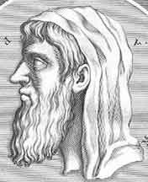
Euclid’s Algorithm for GCD
Finding GCDs by comparing prime factorizations can be difficult when the prime factors are not known!
Euclid discovered: For all ints. a, b, gcd(a, b) = gcd((a mod b), b).
Sort a,b so that a>b, and then (given b>1) (a mod b) < b, so problem is simplified.
Euclid of Alexandria 325-265 B.C.

Slide 16
Euclid’s Algorithm Example
gcd(372,164) = gcd(372 mod 164, 164).
372 mod 164 = 372−164⎣372/164⎦ = 372−164·2 = 372−328 = 44.
gcd(164,44) = gcd(164 mod 44, 44).
164 mod 44 = 164−44⎣164/44⎦ = 164−44·3 = 164−132 = 32.
gcd(44,32) = gcd(44 mod 32, 32) = gcd(12, 32) = gcd(32 mod 12, 12) = gcd(8,12) = gcd(12 mod 8, 8) = gcd(4,8) = gcd(8 mod 4, 4) = gcd(0,4) = 4.
Notes:
Have students come up with other examples and work through them. Maybe start with a 2-digit example.

Slide 17
Euclid’s Algorithm Pseudocode
procedure gcd(a, b: positive integers)
while b ≠ 0 begin
r ≔ a mod b; a ≔ b; b ≔ r; end
return a
Sorting inputs not needed b/c order will be reversed each iteration.
Fast! Number of while loop iterations turns out to be O(log(max(a,b))).

Slide 18
Correctness of Euclidean Algorithm
Lemma 1: Let a = bq + r, where a, b, q, and r are integers. Then gcd(a,b) = gcd(b,r).
Proof:
Suppose that d divides both a and b. Then d also divides a − bq = r (by Theorem 1 of Section 4.1). Hence, any common divisor of a and b must also be any common divisor of b and r.
Suppose that d divides both b and r. Then d also divides bq + r = a. Hence, any common divisor of a and b must also be a common divisor of b and r.
Therefore, gcd(a,b) = gcd(b,r).

Slide 19
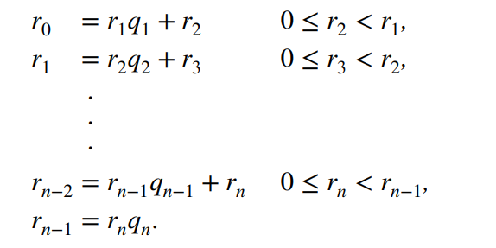
Correctness of Euclidean Algorithm
Suppose that a and b are positive integers with a ≥ b.
Let r₀ = a and r₁ = b.
Eventually, a remainder of zero occurs in the sequence of terms: a = r₀ > r₁ > r₂ > ∙ ∙ ∙ ≥ 0.
By Lemma 1 gcd(a,b) = gcd(r₀,r₁) = ∙ ∙ ∙ = gcd(r_{n-1},r_{n}) = gcd(r_{n} , 0) = r_{n}.
Hence the greatest common divisor is the last nonzero remainder in the sequence of divisions.

Slide 20
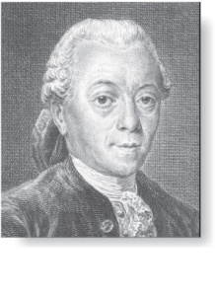
gcds as Linear Combinations
Étienne Bézout
(1730-1783)
Bézout’s Theorem: If a and b are positive integers, then there exist integers s and t such that gcd(a,b) = sa + tb. (proof in exercises of Section 5.2)
Definition: If a and b are positive integers, then integers s and t such that gcd(a,b) = sa + tb are called Bézout coefficients of a and b. The equation gcd(a,b) = sa + tb is called Bézout’s identity.
By Bézout’s Theorem, the gcd of integers a and b can be expressed in the form sa + tb where s and t are integers. This is a linear combination with integer coefficients of a and b.
gcd(6,14) = (−2)∙6 + 1∙14

Slide 21
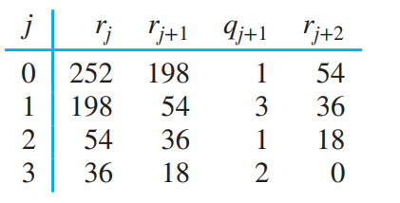
Finding gcds as Linear Combinations
Example 17: Express gcd(252,198) = 18 as a linear combination of 252 and 198.
Solution: First use the Euclidean algorithm to show gcd(252,198) = 18
252 = 1∙198 + 54
198 = 3 ∙54 + 36
54 = 1 ∙36 + 18
36 = 2 ∙18
Now working backwards, from iii and i above
18 = 54 − 1 ∙36
36 = 198 − 3 ∙54
Substituting the 2nd equation into the 1st yields:
18 = 54 − 1 ∙(198 − 3 ∙54 )= 4 ∙54 − 1 ∙198
Substituting 54 = 252 − 1 ∙198 (from i)) yields:
18 = 4 ∙(252 − 1 ∙198) − 1 ∙198 = 4 ∙252 − 5 ∙198
This method illustrated above is a two pass method. It first uses the Euclidian algorithm to find the gcd and then works backwards to express the gcd as a linear combination of the original two integers.

Slide 22

extended Euclidean algorithm
A one pass method, called the extended Euclidean algorithm, is developed in the exercises.
It uses one pass through the steps of the Euclidean algorithm to find Bezout coefficients of a and b,
for j = 2, 3, … , n, where the q_{j} are the quotients in the divisions used when the Euclidean algorithm finds gcd(a, b).

Slide 23
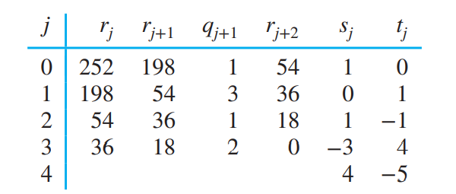
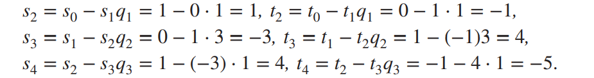
EXAMPLE 18
Express gcd(252, 198) = 18 as a linear combination of 252 and 198 using the extended Euclidean algorithm
q₁ = 1, q₂ = 3, q₃ = 1, and q₄ = 2

Slide 24
Consequences of Bézout’s Theorem
Lemma 2：
If a, b, and c are positive integers such that gcd(a, b) = 1 and a | bc, then a | c.
Proof：
Assume gcd(a, b) = 1 and a | bc
Since gcd(a, b) = 1, by Bézout’s Theorem there are integers s and t such that sa + tb = 1.
Multiplying both sides of the equation by c, yields：
sac + tbc = c.
From Theorem 1 of Section 4.1:
a | sac and a|tbc
a | (tbc+sac)
and We conclude a | c, since sac + tbc = c.

Slide 25
Consequences of Bézout’s Theorem
Theorem 7：
Let m be a positive integer and let a, b, and c be integers.
If ac ≡ bc (mod m) and gcd(c, m) =1, then a ≡ b (mod m).
Proof：
Because ac ≡ bc (mod m), m|ac−bc ⇔ m|c(a−b).
By Lemma 2, because gcd(c, m) =1, it follows that
m|(a − b).
We conclude that a ≡ b (mod m).
14 ≡ 8 (mod 6) but 7 ≢ 4 (mod 6)
24 ≡ 4 (mod 5) and 6 ≡ 1 (mod 5)

Slide 26
Consequences of Bézout’s Theorem
Lemma 3:
If p is prime and p | a₁a₂∙∙∙a_{n}, then p | a_{i} for some i.
proof uses mathematical induction; see Exercise 64 of Section 5.1
Lemma 3 is crucial in the proof of the uniqueness of prime factorizations.
To prove the uniqueness of Prime Factorization.

Slide 27
Uniqueness of Prime Factorization
Uniqueness theorem：
A prime factorization of a positive integer where the primes are in nondecreasing order is unique.
Proof: (by contradiction)
Suppose that the positive integer n can be written as a product of primes in two distinct ways:
n = p₁p₂ ∙∙∙ p_{s} and n = q₁q₂ ∙∙∙ q_{t}
Remove all common primes from the factorizations to get
That, p_{i1} | q_{j1} q_{j2} ∙∙∙q_{jv}
By Lemma 3, it follows that p_{i1} divides q_{jk} for some k, contradicting the assumption that p_{i1} and q_{jk} are distinct primes (why contradicting?).
Hence, there can be at most one factorization of n into primes in nondecreasing order.

Slide 28
Exercise
Use the Euclidean algorithm to express gcd(1001, 100001) as a linear combination of 1001 and 100001.
gcd(100001, 1001) 100001=99*1001+902
=gcd(1001, 902) 1001=1*902+99
=gcd(902, 99) 902=9*99+11
=gcd(99, 11) 99=9*11
=gcd(11, 0)
=11
11=902-9*99
=902-9*(1001-902) = -9*1001+10*902
=-9*1001+10*(100001-99*1001)
=10*100001-999*1001

Slide 29
Exercise
Use the extended Euclidean algorithm to express gcd(1001, 100001) as a linear combination of 1001 and100001.
j | r_{j} | r_{j+1} | q_{j+1} | r_{j+2} | s_{j} | t_{j}
0 | 100001 | 1001 | 99 | 902 | 1 | 0
1 | 1001 | 902 | 1 | 99 | 0 | 1
2 | 902 | 99 | 9 | 11 | 1 | -99
3 | 99 | 11 | 9 | 0 | -1 | 100
4 |  |  |  |  | 10 | -999
gcd(1001, 100001) = gcd(100001, 1001)=10*100001 -999*1001=11

Slide 30
Homework
§4.3
16, 24(a,c,f), 30,40(a,c,e,g,i)

